Slide 1
Summit Equipment Rental Data Pipeline
A Synthesis Prototype — CIDM-6395 Capstone
Alexander J. Lawson
May 2026

Slide 2
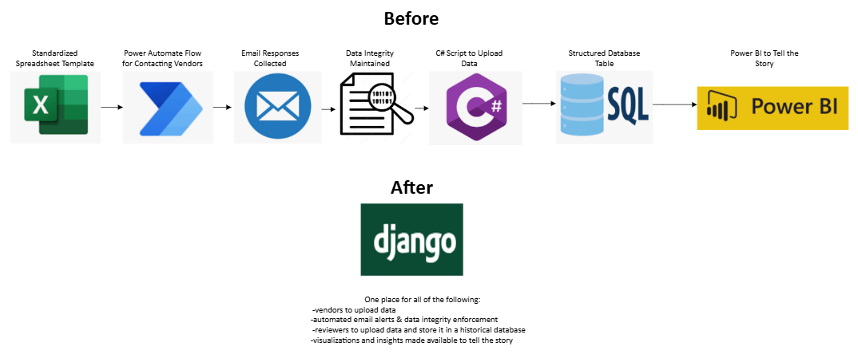
Summit Equipment Rental Data Pipeline
The Problem
$2M–$3M annual equipment rental portfolio
25+ third-party vendors across the country
Data collection relied on a single person, a spreadsheet template, and manual email follow-ups, policing i.e. Repetitive, tiresome overhead to maintain.
Any absence, turnover, or error in that pipeline risked corruption of the entire analytical foundation

Slide 3
Summit Equipment Rental Data Pipeline
The Solution
Vendors log in and upload their own data — no spreadsheets, no email
Automated data integrity enforcement at the submission layer
A reviewer consolidates, validates, and publishes to a permanent master ledger
Embedded analytics serve live insights directly — no external BI tool required

Slide 4
Summit Equipment Rental Data Pipeline
The Four Pillars
Pillar | Metaphor | Role in This Project
Software Systems (SS) | The Muscle | Django MVT, role-based views, vendor portal, management commands, SDLC documentation
Business Analytics (BA) | The Brain | Plotly analytics dashboard — Cost Over Time, Compliance, Rent vs. Buy, Week Comparison
Data Management (DM) | The Skeleton | Normalized schema, staging → master publish workflow, audit table, ORM migrations
Cybersecurity & Networking (CN) | The Nervous System | Login required on all views, middleware-enforced routing, OTP 2FA, CSRF protection

Slide 5
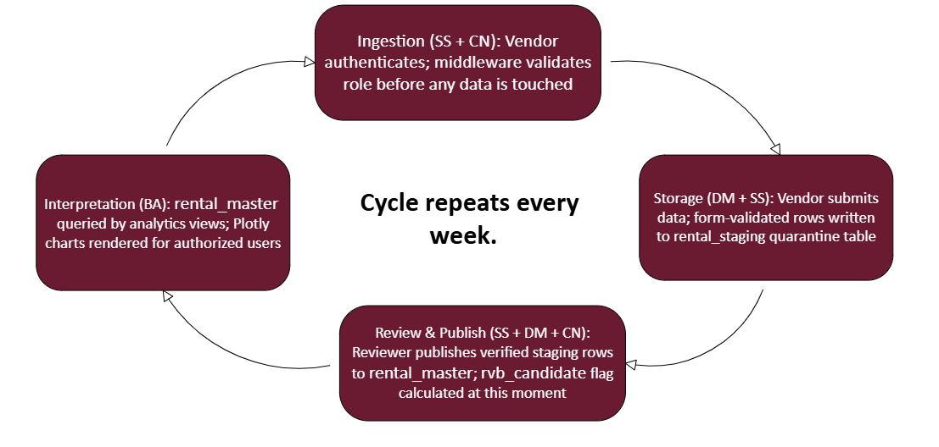
Summit Equipment Rental Data Pipeline
How the Pillars Connect

Slide 6
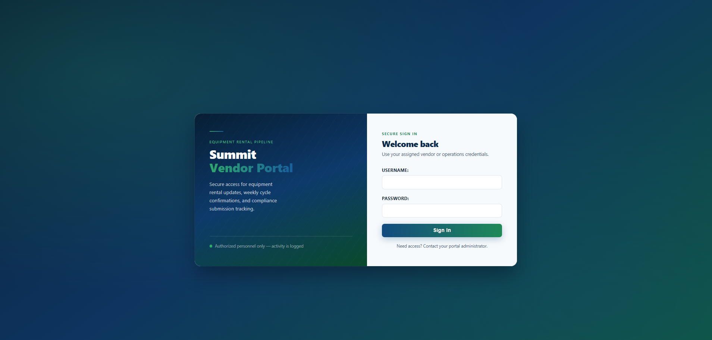
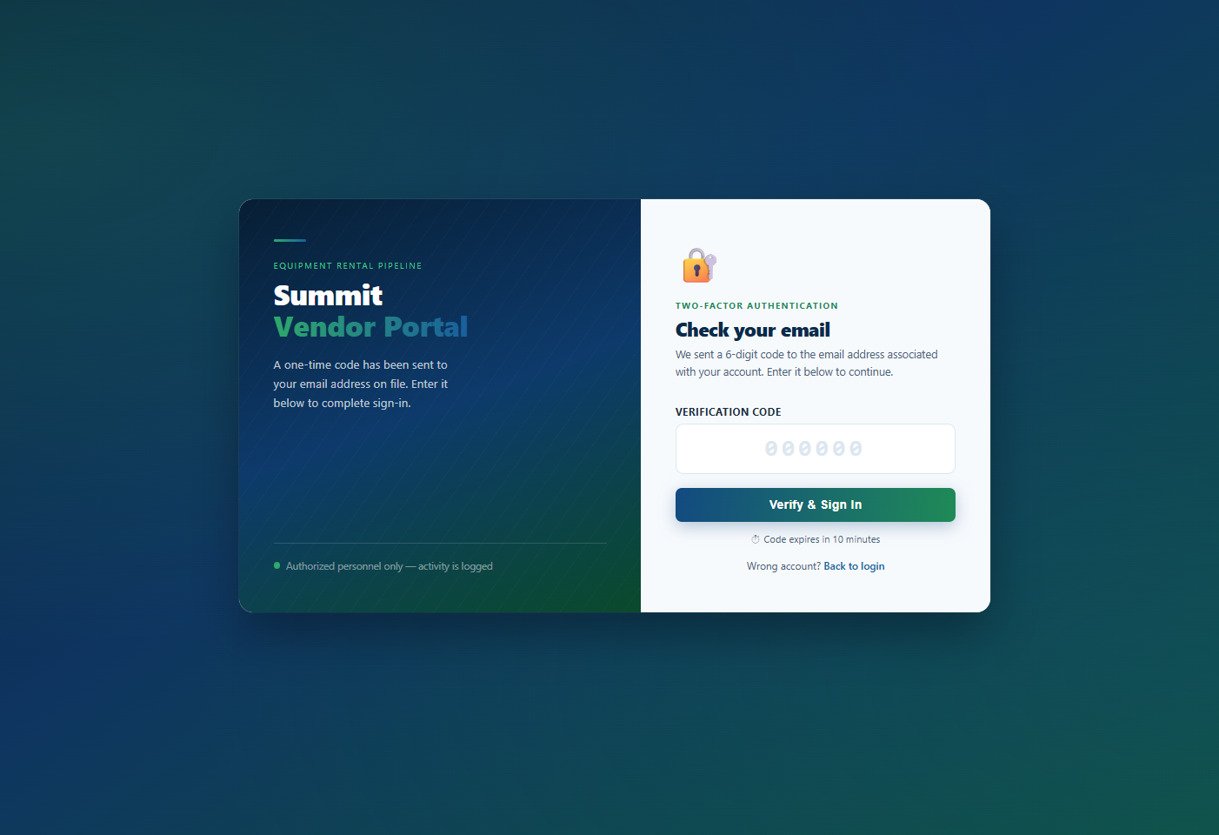
Summit Equipment Rental Data Pipeline
Demo: Secure Login & 2FA
All accounts — vendors, reviewers, and admin — require 2FA to enter. No SMTP in demo: code is always 111111.

Slide 7
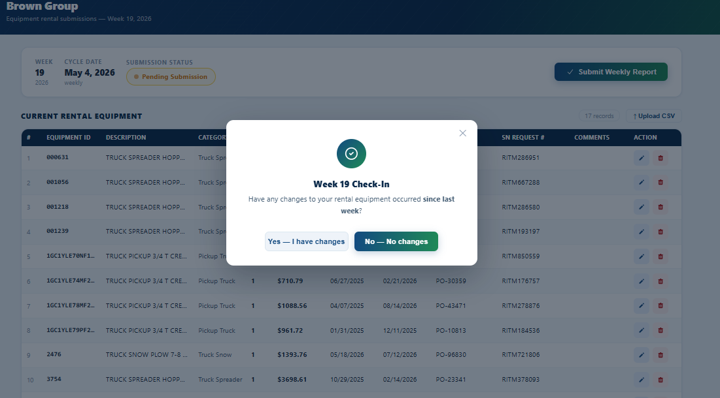
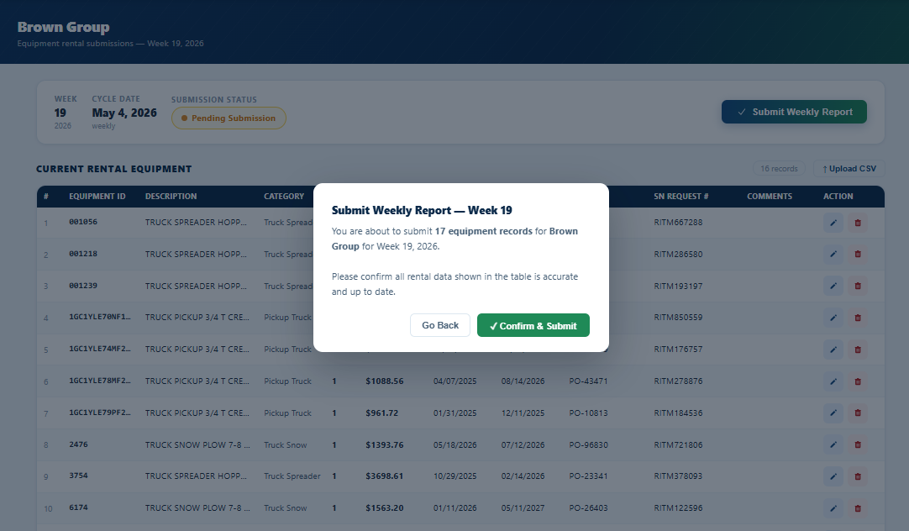
Summit Equipment Rental Data Pipeline
Demo: Vendor Portal
Clear declaration of whether or not any changes have been made since last check-in
Vendor sees only their own data — no cross-vendor visibility
Inline editing: each row has edit/delete actions
CSV upload available for bulk changes
"Submit Weekly Report" locks the cycle and records the timestamp in VendorAudit

Slide 8
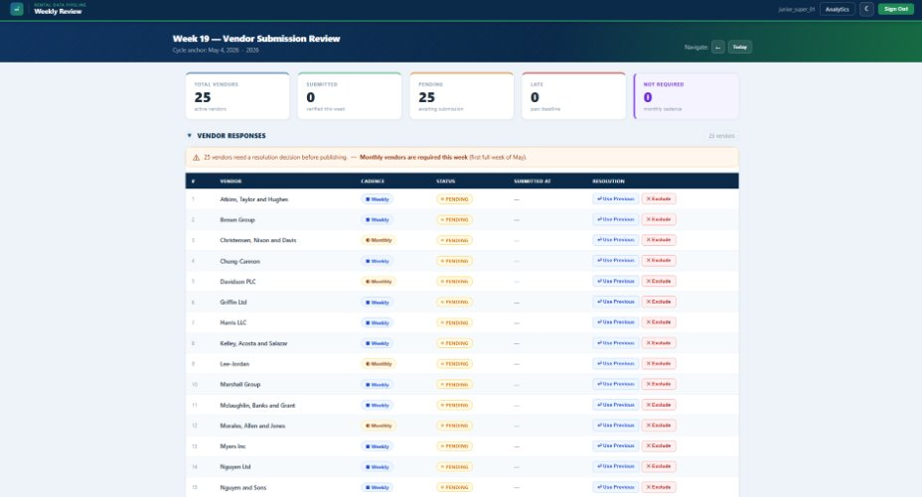
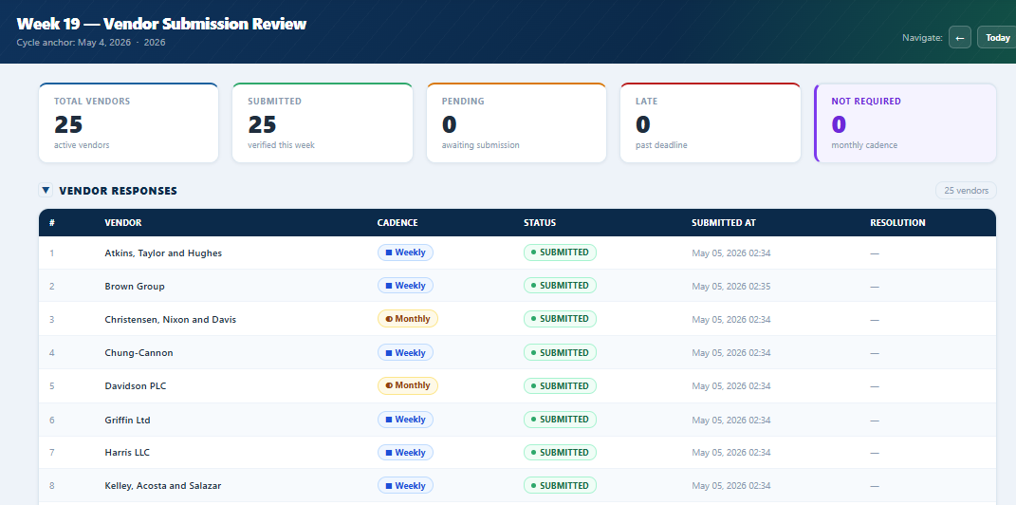
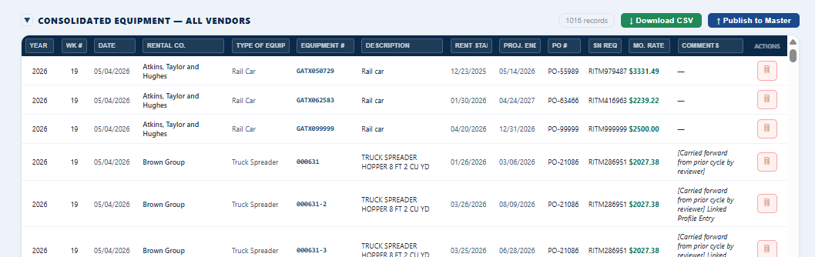
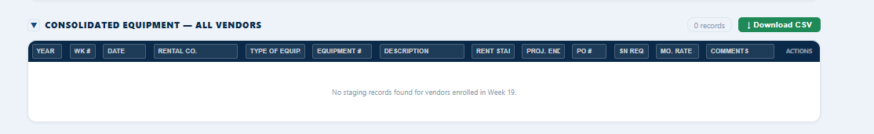
Summit Equipment Rental Data Pipeline
Demo: Reviewer Portal
Reviewer sees all vendors consolidated into one table
Download CSV available for offline audit
Publish is irreversible — confirmation modal enforces intent
After publish, all 1474 rows move from rental_staging to rental_master

Slide 9
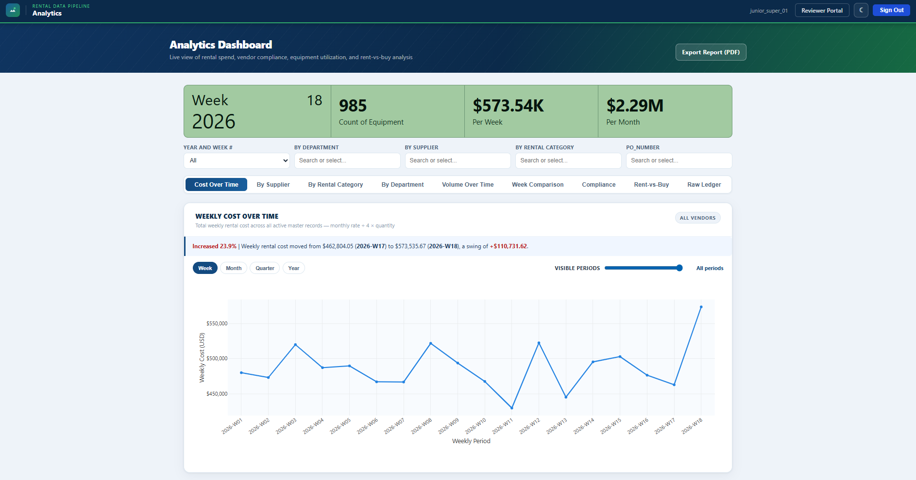
Summit Equipment Rental Data Pipeline
Demo: Analytics – Spend Over Time
Customizable filtering by vendor, department, rental category, PO number
"Export Report (PDF)" button for management reporting
Live summary KPIs: equipment count, weekly spend, monthly run rate
Chart shows Week 1–18 of 2026 — spend trend visible across the year

Slide 10
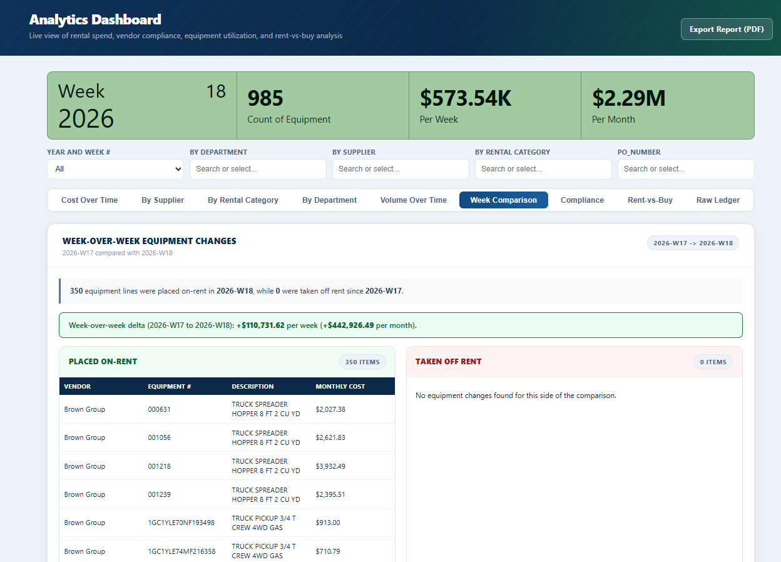
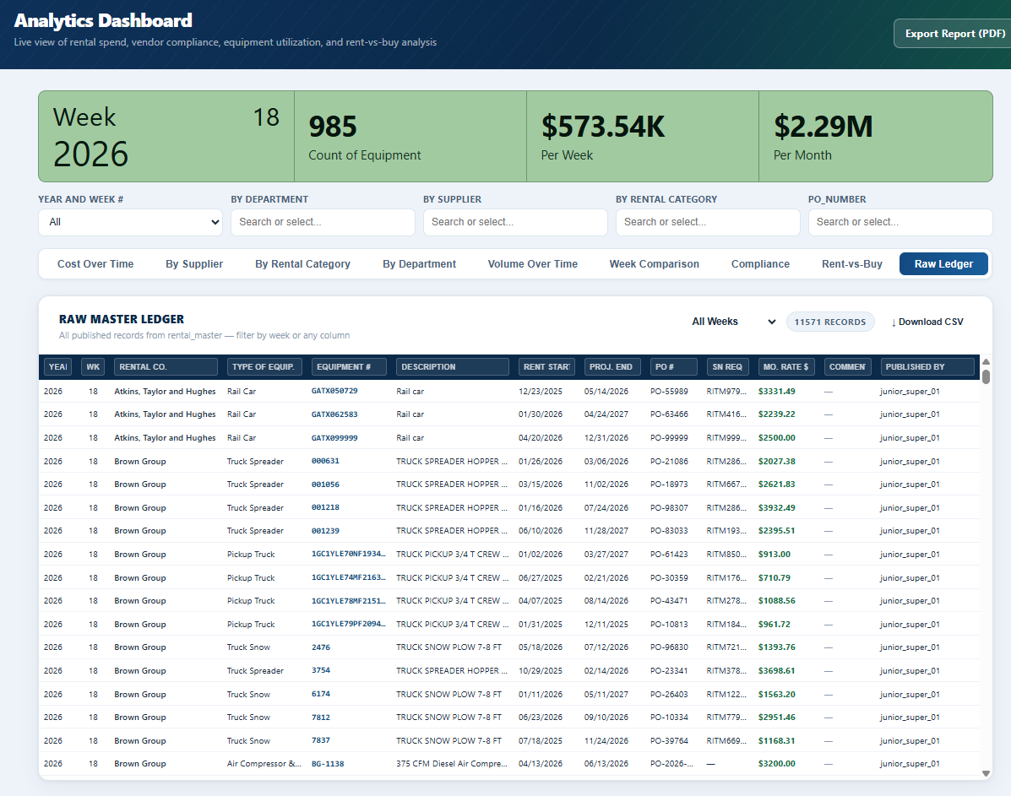
Summit Equipment Rental Data Pipeline
Demo: Analytics – Weekly Comp & Raw Ledger
Weekly Comp to show plainly what was taken on/off rent week to week
Basic table that shows the entirety of the DB

Slide 11
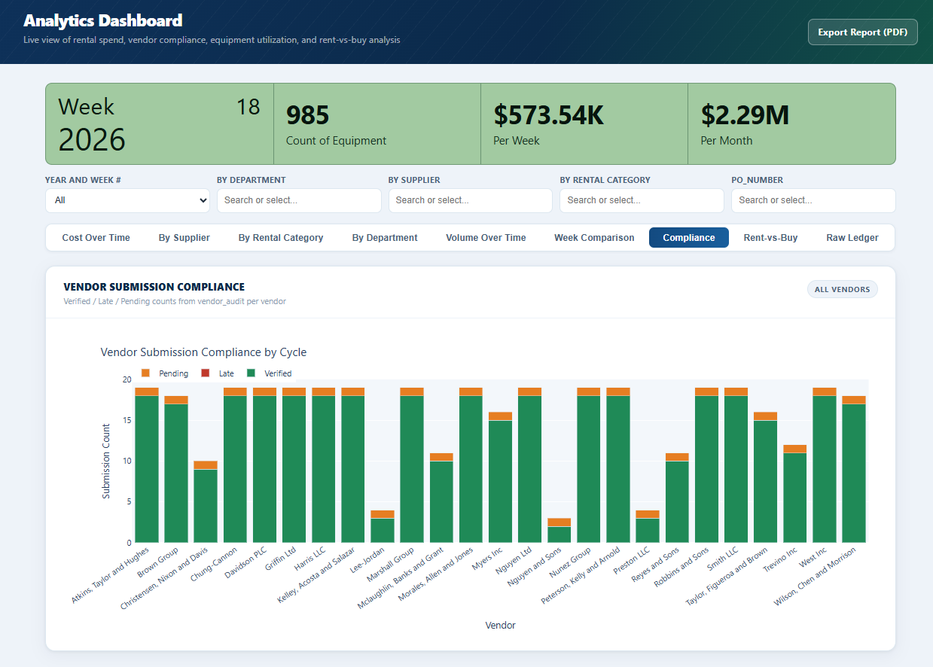
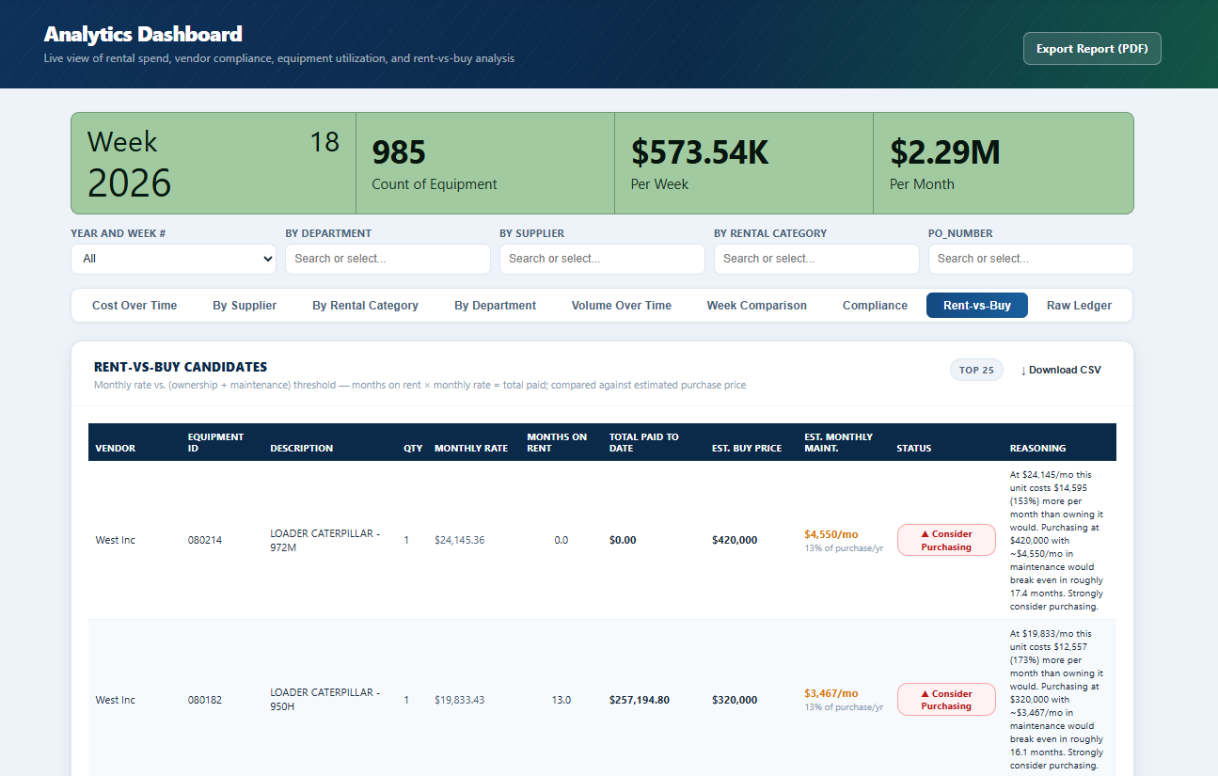
Summit Equipment Rental Data Pipeline
Demo: Analytics – Compliance & Rent v. Buy
Compliance chart: instant visibility into which vendors have submitted, which are late, which are pending
Rent-vs-Buy: automatically calculated when a record crosses the monthly rate threshold relative to purchase price + maintenance
"Consider Purchasing" flag surfaces directly from data — no analyst intervention required

Slide 12
Summit Equipment Rental Data Pipeline
The Fully Realized Vision
What this system would look like in production
Infrastructure & Security
PostgreSQL replacing SQLite(concurrent users, row-level locking)
HTTPS / TLS enforced at the load balancer level
Live OTP email delivery via SendGridor AWS SES (no hardcoded codes)
Audit log table capturing every publish, edit, and delete action with user + timestamp
Analytical Capabilities
Multi-year trend analysis as the master ledger grows
Budget variance tracking: actual spend vs. departmental allocation
Automated late-submission alerts and vendor scorecards
AI-assisted anomaly detection on rate outliers (sudden spikes in monthly rate for the same asset)
Operational Workflow
Automated weekly cycle advance — no manual management commands needed
Email reminders to vendors approaching their submission deadline
Role expansion: department budget approvers with limited-scope analytics access
CSV import from vendor ERP systems(reducing manual entry entirely)

Slide 13
Summit Equipment Rental Data Pipeline
Synthesis Reflection
Pillar | Metaphor
Software Systems | There is no application. No portal, no forms, no publish action. The entire pipeline disappears.
Business Analytics | The data is collected and stored, but no one can interpret it. Decisions revert to gut feel and spreadsheets.
Data Management | There's no schema to enforce integrity. Vendors submit garbage. The "master ledger" is meaningless.
Cybersecurity & Networking | Any user can reach any view. Vendors see competitors' data. The dataset is compromised before it starts.

Slide 14
Summit Equipment Rental Data Pipeline
Conclusion
Thank you
Summit Rental Data Pipeline
Alexander J. LawsonCIDM-6395 Capstone | West Texas A&M University | April 2026
GitHub Repo URL —
Hosted demo URL — https://cidm-6395-alexander-lawson.onrender.com/login/

